Slide 1
The Maternal, Newborn, and Children’s Simulation Program

Slide 2
The Basic Assumption
We believe that everyone participating in this Simulation Program is:
Intelligent...
Well trained...
Cares about doing their best...
And wants to improve
Adapted from the Institute for Medical Simulation, Harvard Medical School

Slide 3
Aims
Discussion around:
Crisis Resource Management
The How & Why of Simulation

Slide 4
Tennis Ball Game…

Slide 5
Introduction to Crisis Resource Management
‘To Err is Human’
building a safer healthcare system.
Institute of Medicine, 2000
It’s how we deal with the error that is important

Slide 6
Crisis Resource Management = “Non-technical” skills Training = “Human Factors” Training
Developed for the aviation industry
Realisation that many incidents occurred as a result of poor leadership, communication, &/or utilisation of resources
Adapted by a number of industries, including the Health, to improve patient & staff safety

Slide 7
Definition of Non-technical skills, .......or Human Factors
Set of (i) behaviour &
(ii) cognitive skills
independent of our technical competence
(Yule et al 2006)
How we behave & think in a crisis

Slide 8
Equation to successfully manage a Critical Event
Recognition of the Crisis
+
Appropriate Management
+
Optimal Team Performance
+
Human Factors

Slide 9
Traditional thinking
Our technical skills
Patient risk factors
Outcome

Slide 10
Contemporary thinking
Individual skills:
technical
non-technical
a) cognitive (eg decision making)
b) behaviour (eg leadership)
Patient risk factors
Outcome
Teamwork & Communication amongst team
Environment
(eg distractions, interruptions, stress)

Slide 12
How do you feel after watching this video?
What issues does it bring up?
Do you recognise anything familiar in the way your team practises?

Slide 13
Crisis Resource Management (CRM) Principles
Leadership (& followership)
Communication
Call for help
Get the right people in the right roles
Utilise all resources
Avoid fixation

Slide 15
How do you feel after watching this video?
What issues does it bring up?
Do you recognise anything familiar in the way your team practises?

Slide 16
Simulation gives us a chance to practice our non-technical skills

Slide 17
Crisis Resource Management (CRM) Principles
Leadership (& followership)
Communication
Call for help
Get the right people in the right roles
Utilise all resources
Avoid fixation

Slide 18
What factors influence learning in Simulation?
Emotional activation influences retention of knowledge

Slide 19
Your emotional state....
Simulation

Slide 20
Yerkes-Dodson Law
Good performance
with optimal stress
Easy Tasks
Difficult Tasks
Poor performance
with high stress
Poor performance
with low stress
Performance
Poor Good
Low Moderate High
Level of Stress

Slide 21
What factors influence learning in Simulation?
2. Deliberate practise and reflection

Slide 22
Simulation helps us go through all stages of the Kolb learning cycle

Slide 23
Experience
Simulation
Deliberate Practice
Experimentation
Reflection
Repetitive action
Debrief
Kolb 1984
Notes:
Simulation is a great tool for reinforcing Kolb’s cycle of adult learning as it reinforces learning through deliberate practise and reflection.
Go through the cycle
Experience and conceptualization allows participants to grasp knowledge
Experimentation and reflection allows participants to transform that knowledge (light globe comes on...)

Slide 24
Simulation allows us to practise critical event in a safe environment, learn to minimise error, improve safety, quality and teamwork

Slide 25
What factors influence learning in Simulation?
3. Debriefing with “good” judgement

Slide 26
Why do we debrief?
Facilitates open/safe discussion
Allows analysis of the participants actions & allows the learners to make meaning of what happened

Slide 27
Why do we debrief?
“Meant is not said
Said is not heard
Heard is not understood
Understood is not done”
Rall, M & Dieckmann, 2005

Slide 28
Summary Crisis Resource Management Principles encompass:
Leadership (& followership)
Communication
Call for help
Get the right people in the right roles
Utilise all resources
Avoid fixation

Slide 29
Summary
Simulation:
Incorporates adult learning principles
Allows practise without risk in a safe environment
Accelerates learning
Through Crisis Resource Management
Reinforces good communication techniques & teamwork
Requires debriefing with ‘good’ judgementt
Notes:
Simulation allows for practice without risk, utilising adult learning principles, allowing for development of good communication techniques and can be debriefed using ‘good judgement’

Slide 30
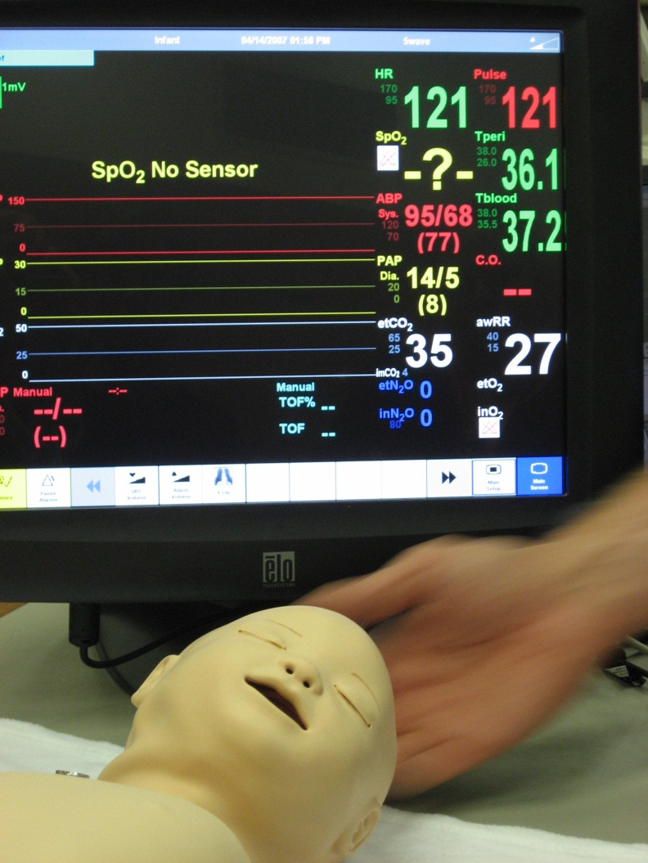
What do we need you to do today
Participate
Perform
Communicate
Analyse and react to the
situation
Suspend disbelief
Notes:
What we need you to do today in the sims is....
AND ENJOY!

Slide 31
And Remember…….

Slide 32
Notes:
Thankyou….and does anyone have any questions?

Slide 33
References
Feldman-Barrett & Russell, 1998
Gaba, D. M. (2010). Crisis resource management and teamwork training in anaesthesia. British Journal of Anaesthesia, 2009; 105(1), 3-6.
Kohn, Institute of medicine, 2000
David Kolb, 1984
Rall, M. & Dieckmann, P., Errors in Medicine, Patient Safety and human Factors, Euroanesthesia, 2005

Slide 34
References
Rudolph, J. W., Simon, R., Dufresne, R. L., & Raemer, D. B. (2006). There’s no such thing as “nonjudgmental” debriefing: A theory and method for debriefing with good judgment. Simulation in Healthcare, 1(1).
Undre, Arora, Sevdalis 2009
Yule, S., Flin, R., Paterson-Brown, S., Maran, N., & Rowley, D. Development of a rating system for surgeons' non-technical skills. Medical Education, 2006; 40(11), 1098-1104.

