Slide 1
Simulated Learning Environments

Slide 2
Late 2011 HWA invited submissions for funding to support and expand Simulated Learning Environments (SLE). Eastern Health was successful in this endeavour receiving 2.3M.

Slide 3
The project is aligned to the following initiatives:

Slide 4
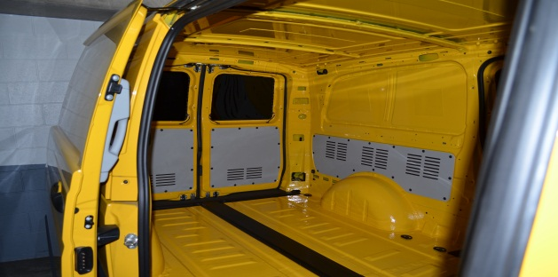
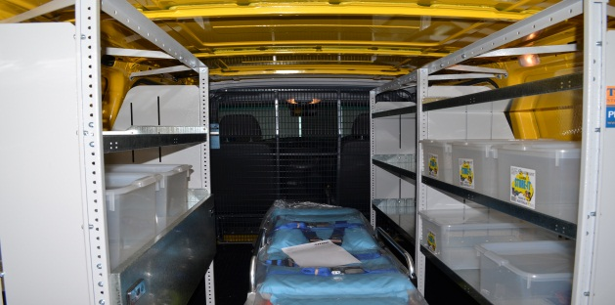
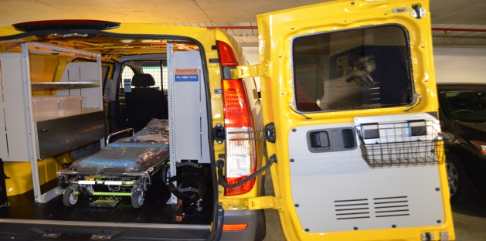
A mobile simulation van – to serve the breathe of EH and be accessible to the broader Eastern Clinical Placement Network (CPN) catchment

Slide 5
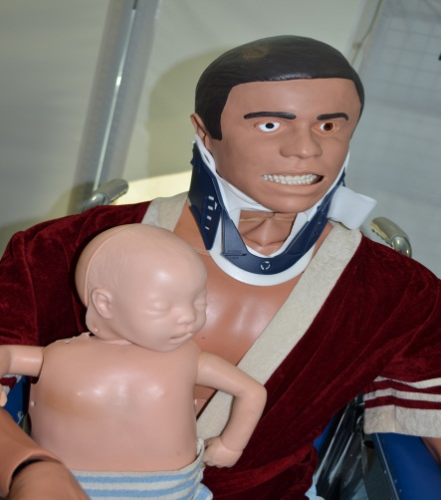
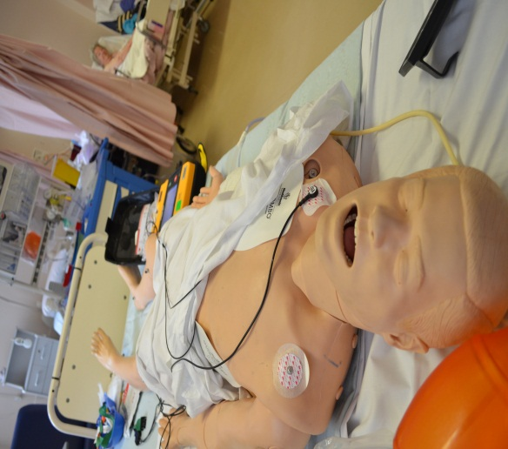
Key personal to develop simulation capacity and coordination across the health service

Slide 6
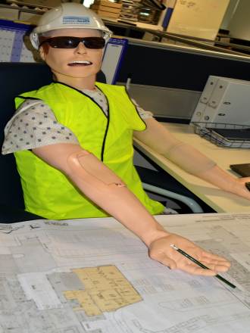
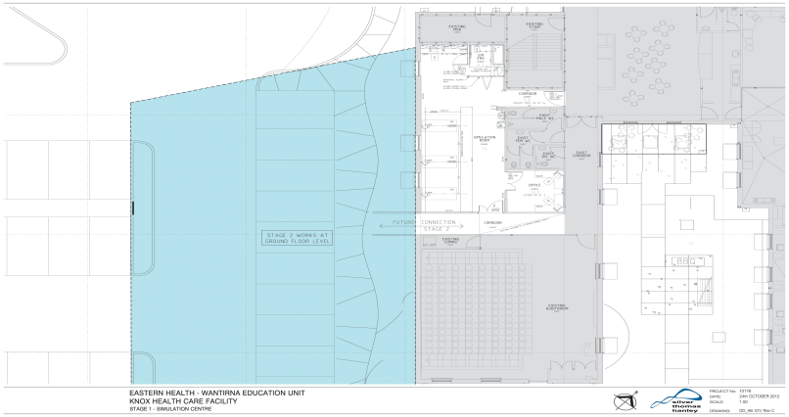
An interdisciplinary student ward – located at Wantirna
Simulation training facilities within the proposed education precinct at Wantirna

Slide 7
Progress to Date
Mobile simulation van operational
All major sites across EH now have simulation resources
$850K spent on equipment
Stage one of the Wantirna build to be completed in February 2013
Building internal resources to develop an integrated simulation campaign across EH

Slide 8
Where to from here??
On line booking systems to become effective late January 2013
Continue to build internal resources to enable sustainable programs
Development of an equipment catalogue to showcase resources both internally and externally

