Slide 1
Wantirna Education Precinct

Slide 2
In 2010 Eastern Health was successful in obtaining capital funding to build a state of the art education precinct at the Wantirna site. The project has evolved and is now a collaboration with Tertiary partners and combined funding.

Slide 3
Progress to date
Stage one: Demolition and construction of a 3 bedded simulation centre, incorporating a simulated bathroom

Slide 4
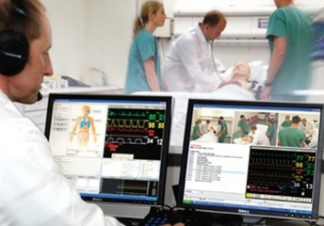
Progress to date
Full AV and recording facilities will be incorporated into the construction

Slide 5
Progress to date
To be completed in February 2013

Slide 6
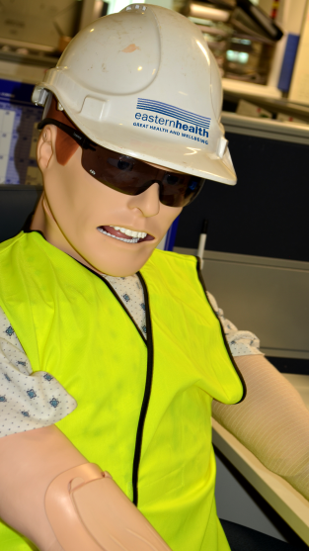
Stage Two
The construction of a two storey multipurpose education precinct

Slide 7
Stage Two
Incorporating an extra 60 seated lecture theatre

Slide 8
Stage Two
Multipurpose educational spaces including tutorial rooms, meeting rooms and open space areas.

Slide 9
Stage Two
All spaces will be equipped with wireless internet access and integrated AV facilities

Slide 10
Where to from here??
Planning and consultations continue
Construction to be completed by December 2013

