Slide 1
Reflection as a clinical educator
GRACE Session 16

Slide 2
Session aims
To encourage reflective processes related to your learning during the GRACE course and your developing expertise as a clinical educator
AND
To introduce you to strategies to enable you to assist others to reflect on their practice in the workplace

Slide 3
Relevance of reflection
Essential process in:
Developing professional competence
Being a lifelong learner and searching for meaning
Ongoing professional and personal development
Making sense of the activities in the TLOF and the challenging learning situation
Applying theory to practice to explain or predict
Kolb’s learning cycle
Baird & Winter (2005) in Rose & Best
Notes:
Note this slides begins with general statements of the relevance of reflection to the development of clinical competence and then shifts to personalise reflection as a learning process in the GRACE.

Slide 4
Schön’s Reflective Practice
Experience /event
Surprise
Reflection–in-action
Experimentation
Reflection–on-action
Kaufman 2003
Notes:
Donald Schon‘s work in the 1980’s extended earlier thinking in highlighting the importance of reflection in professional practice..
Note that novices are so busy doing that they have difficulty reflecting in action as well. It is a bit like talking when you first start driving a car or riding a bike. You may need to help learners structure pauses throughout to reflect on aspects of practice.

Slide 5
Skills needed for reflection
Self awareness
Description, being able to :
recognise
recall
describe the event
Critical analysis
Synthesis
Evaluation
Boud Keogh & Walker 1985 in Wainwright et al 2010

Slide 6
Methods to encourage reflection
Peer discussion
Reflective writing: journals, diaries, templates
Modeling the process
Self disclosure
Talking aloud
Sharing a journal
Baird & Winter 2005 in Rose & Best

Slide 7
Example of a template
Student Reflective Practice tool developed for Community Health (Gippsland, 2012)
Describe: What happened?
Analyse: What did you learn?
Action plan: What will you do now? i.e. implications for future practice
Notes:
Many cycles of reflection in the literature and this process draws on key stages of the Gibbs cycle see P 150 Rose and Best

Slide 8
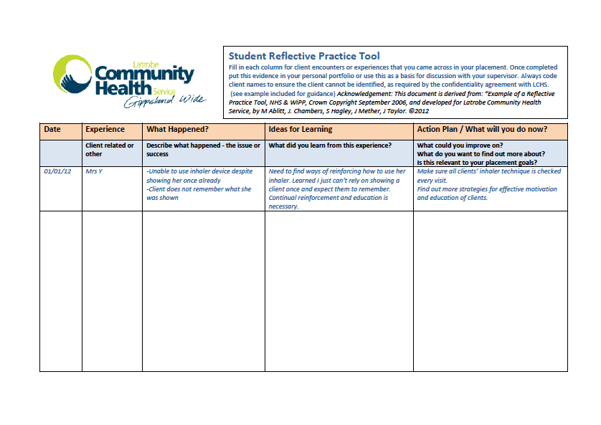
Notes:
Copy in Participant Booklet

Slide 9
Encouraging reflective practice
Being effective relates to:
Recognition of the importance of reflection
Supportive learning environment
Opportunity for good role models
Scheduling time
Using a variety of different methods
Baird & Winter 2005 in Rose & Best

Slide 10
Making sense of your GRACE experience
Get comfortable, pen and paper at hand
Use the next (quiet) 5 minutes to reflect on your experiences during the GRACE course
Refer to the GRACE time table, the papers on the wall in the room and your own working papers as triggers
Write… your highlights, your questions, your feelings. What ever comes to mind!

Slide 11
Verbal Debriefing
In pairs
Participant 1 ( Reflector)
responds to the prompting questioning and active listening of partner
Participant 2 (Facilitator)
Uses active listening and the suggested questions to assist reflection.

Slide 12
Some suggested questions
What were the highlights for you of the GRACE course… Why?
Were there any bits you found difficult?
Do you know why?
What ideas will you implement in your clinical education practice?
What were the surprises for you during the course?

Slide 13
Your reflection on learning
Refer Participant Book
Check your responses to the Day 1 self-evaluation homework task as related to the BPCLE
Refer to your notes throughout the GRACE course
What strategies do you have for the future?
Notes:
HANE

Slide 14
Your personal critical reflection
Complete the final page in your Participant book for future reference
Best wishes for your future practice as a GRACE supervisor
Enjoy being a clinical educator!!
Notes:
Time allowed for writing is

